Slide 1
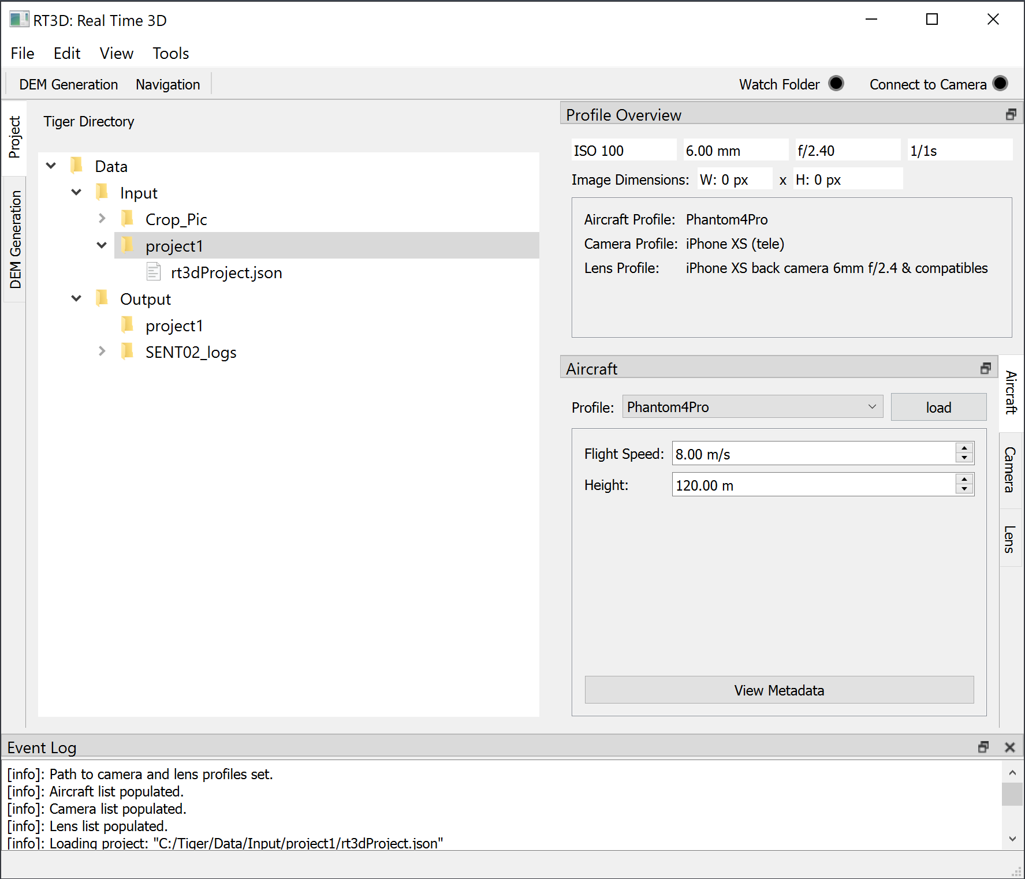
RT3D User Guide: UI Components
File Menu
Edit Menu
View Menu
Tools Menu
Tiger Directory View
Project View Tab
DEM Generation View Tab
Image Watchdog: Folder
Image Watchdog: Connect to Camera
Profile Overview dock
Profiles dock
Aircraft Profile Tab
Camera Profile Tab
Lens Profile Tab
Event Log
Launch DEM Generation
Launch Waypointer Navigation
1
2
3
4
8
9
16
17
5
6
10
7
11
12
13
14
15
Miscellaneous Features
Convert .dat files into .tiff files
The RT3D DEM generation process creates DEM files in .dat byte data files.
The first 16 bytes contains a header giving the number of rows and number of columns, in that order.
Under windows 10, the byte order of these files is little-endian and data follows column-major (Fortran-style) index order.
RT3D enables the user to convert these .dat files into .tiff files in one of two ways:
From the file in the Tiger Directory Tree view, select and right click the file and choose `Convert to Tiff `
From the Edit menu, select Edit > Convert > DAT to TIFF
If a folder is specified, then all .dat files within the folder will be converted into .tiff.
Note, the original .dat file will not be deleted.
View the Event Log
Activating the event log allows the user to track some of the processes within RT3D. It can be activated from the view menu by selecting, View > Event Log. A log file is created in the same directory as the rt3d_version.exe program under `Path/To/rt3d/logs` which contains the same information. This file is overwritten each time the application is launched, so it must be copied if the user wishes to save a log.

Slide 2
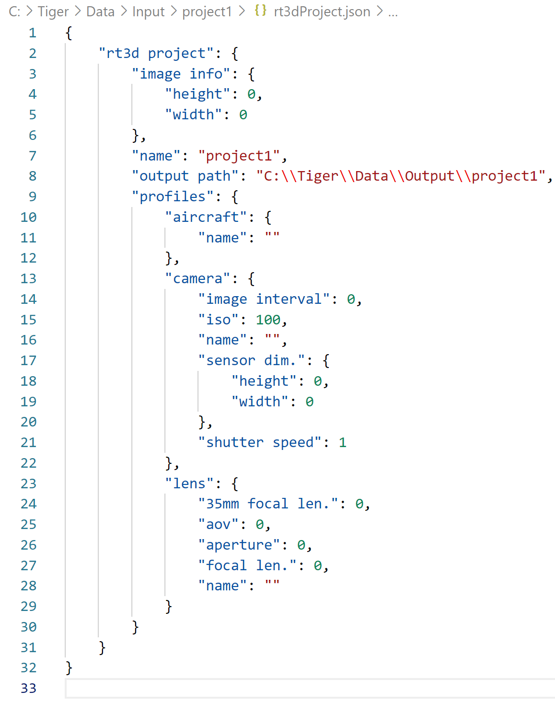
User Guide: RT3D Projects
A RT3D project is an organisational unit defined in a plain text .json configuration file.
Newly created project configuration files will be named rt3dProject.json and placed within a folder
Projects define:
input and output directories,
log file names,
settings file locations,
record of the device profiles
and algorithm hyper-parameters.
Creating a new project will make folders within the input and output folder under the C:\Tiger directory tree.
Loading a project will automatically populate these fields.
Create a new project
New Projects can be create one of two ways:
To create a new project from the file menu:
Select, File > New > Project (shortcut: ctrl + shift + N)
Enter the name for the project
To create a project from a folder in the Tiger directory Tree view
From the Tiger Directory Tree View, select that does not already contain a rt3dProject.json file or create a new folder
Right click on the folder and select `Create Project`
To open a project, do one of the following:
From the file menu,
select File > Open Project (shortcut: ctrl + O)
In the Open Project dialog that opens, find the location of the desired project folder and click `Select Folder`. Project folders contain rt3dProject.json files.
From the Tiger directory Tree view
Find the location of the desired project folder (containing a rt3dProject.json)
Right click on the folder and select `Open Project`
Save an open project
Open projects can be saved from the file menu, File > Save Project (shortcut: ctrl + S).
Edit the project configuration file
The current projects configuration file (rt3dProject.json) can be opened for editing in the Edit menu, Edit > Project Config. This will open the file in the systems default text editor (usually MS Notepad).

Slide 3
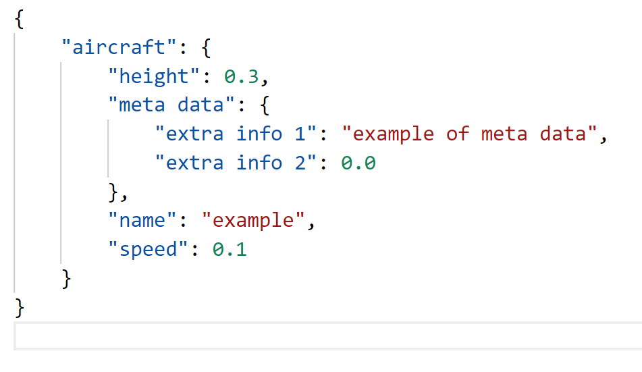
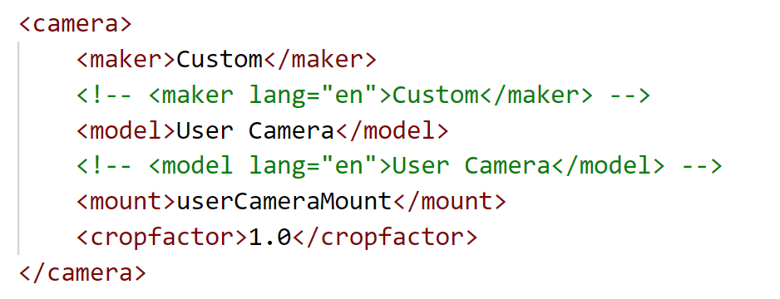
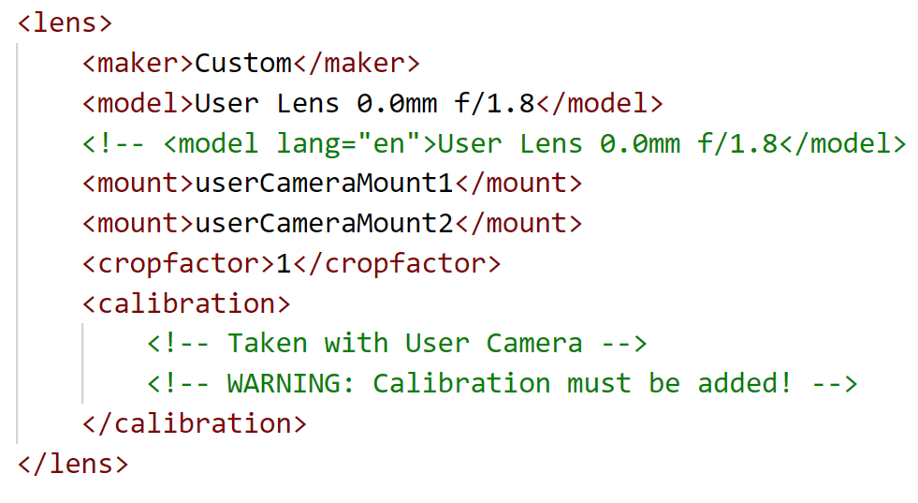
User Guide: Device Profiles
The device profiles are inbuilt modules for configuring and recording the state and meta-data of various hardware components. These features make setup, navigation, and use of the software more efficient and straight forward.
Supported Device Profiles are:
Aircraft
Camera
Lens
Loading Profiles:
Profiles can be loaded within their respective UI tabs by choosing a profile from the `Select Profile` combo box and selecting load.
Aircraft Profile
Aircraft profiles are saved in plain text .json files. This file contains information about the aircraft, such as the aircraft name, height (above ground), and speed. Additionally, the profile contains a field for meta data which can be filled with any additional information useful for keeping record of specifics about the UAV. Selecting `View Meta Data` will open the aircraft profile in the system default text editor for .json files (defaults to MS Notebook). Entries to the metadata following standard json object format of {“key”: “value”} pairings. String values require double quote encapsulation, purely numeric values do not.
Adding a new Aircraft Profile
Populate the UI fields under the Aircraft Profile tab with the desired settings.
From the File menu, select File > New > Aircraft Profile.
In the Save Aircraft Profile dialog that opens, specify the aircraft profile name and select save.
The new profile will be saved using the current values specified in the Aircraft Profile UI fields.
Updating a Aircraft Profile
Follow the steps 1 and 2, as above
In step 3, choose an already existing profile file to overwrite it.
Camera Profiles
Aircraft profiles are stored in in plain text XML files and are backed by the Lensfun Library.
Adding a new Camera Profile
Populate the UI fields under the Aircraft Profile tab with the desired settings.
From the File menu, select File > New > Camera Profile.
The new profile will be saved using the current values specified in the Camera Profile UI fields.
Lens Profiles
Lens profiles are stored in in plain text XML files and are backed by the Lensfun Library.
Adding a new Lens Profile
Populate the UI fields under the Aircraft Profile tab with the desired settings.
From the File menu, select File > New > Camera Profile.
The new profile will be saved using the current values specified in the Camera Profile UI fields and open in the default text editor. Note that the lens calibration data will be empty and needs to be populated manually (see Declaring Lenses).
See User Guide: Declaring Lens and Camera Profiles for detailed descriptions of camera and lens profiles.

Slide 4
Declaring Cameras: <lens>
User Guide: Declaring Lens and Camera Profiles
Possible embedded elements:
<maker>string</maker>
Camera maker. This must be specified exactly as it is returned by EXIF, however, upper and lower case doesn't matter, neither does the ordering of the “words” in the camera maker name.
<model>string</model>
Camera model. This must be specified exactly as it is returned by EXIF, however, upper and lower case doesn't matter, neither does the ordering of the “words” in the camera model name.
<variant>string</variant>
Camera variant. Sometimes makers create several cameras without changing EXIF information. Unfortunately, camera variant cannot be automatically detected so this is a manual choice item. This field can also be used to deal with cameras with more than one aspect ratio. For every available aspect ratio, make a copy of the <camera> entry, entering the aspect ratio into the <variant> field (e.g. <variant>16:9</variant>). Of course, the crop factor may have to be adapted as well.
<mount>string</mount>
Camera mount. There can be only one such element in camera declaration. If you want to specify that it is possible to use lenses with a different mount on this camera, use the <compat> element in mount declaration.
<cropfactor>number</cropfactor>
Camera crop factor. This is the ratio between the standard film frame diagonal (36x24mm) and camera sensor diagonal. Should be as accurate as possible.
Declaring Camera mounts: <mount>
Add <mount> element only for mounts for interchangeable lenses. Possible embedded elements:
<name>string</name>
This gives the name of the mount. Mount names for fixed-lens cameras – and only they – must start with a lower case letter.
<compat>string</compat>
Declares that this mount is compatible with another one.
Usually this means that either they are directly compatible (e.g. the Pentax KAF2 mount is compatible with Pentax K so you can insert K lenses into a KAF2 camera) or there exists mount adapters which permit to install lenses with such mounts into this mount.
Note that the compatibility is unidirectional, e.g. in the above example it doesn't say that you can insert Pentax KAF2 lenses into a Pentax K camera; if you need a two-way compatibility, declare it both ways. Also the “compatibility” is restricted in the sense that if mount A is compatible with mount B (e.g. you can put B lenses on an A camera), and mount B is compatible with mount C, this does not necessarily mean that mount A is compatible with mount C. If you need to make mount A compatible with mount C, declare it so explicitly.
Declaring lenses: <lens>
Possible embedded elements:
<maker>string</maker>
Lens maker.
<model>string</model>
Lens model. This must be specified exactly as it is returned by EXIF, however, upper and lower case doesn't matter, neither does the ordering of the “words” in the lens model name.
<type>string</type>
Lens type. This is one of: “rectilinear", “fisheye”, “panoramic”, “equirectangular”, “orthographic”, “stereographic”, “equisolid”, “fisheye_thoby”. If this field is not given, rectilinear is assumed.
<focal min="number" max="number" value="number" />
Lens focal length in mm. This can be either a single value for a fixed-focal length lens, or a minimum and maximum value in the case of a zoom lens.
<aperture min="number" max="number" value="number" />
Lens aperture as the f-number. This can be either a single value for a fixed-aperture lens (in rare cases), or the minimal and maximal possible f-stop number for this lens (over the whole zoom range for a zoom lens).
<mount>string</mount>
Lens mount. There can be multiple <mount> entries if the same lens is manufactured with several mounts, or it has a variable mount (e.g. Tamron Adaptall).
<cropfactor>number</cropfactor>
This is the crop factor of the camera with which all shots for computing distortion models were made. The library will compute correction factors if you used this lens on another camera with a different crop factor. Generally it is advised to use a camera with maximal crop factor for this lens, because the models may become imprecise for crop factors smaller than the one used for models.
<aspect-ratio>number</aspect-ratio>
This is the aspect ratio of the camera with which all shots for computing distortion models were made. It is the ratio of the longer edge to the shorter edge. The library needs the aspect ratio internally for correct application of the distortion parameters. You may give it is as a real number or as a ratio with a colon like “4:3”. It defaults to 1.5 or 3:2.
<center x="number" y="number" />
The decentring of the lens, i.e. the offset of its optical axis from the centre of the view frame. “x” denotes the offset in horizontal direction, “y” in vertical direction. The scale is so that the smaller dimension (for very most cameras the height) has the value 2. Both offsets default to 0. It may be particularly helpful for shift lenses.
<calibration>calibration data</calibration>
<distortion focal="number" model="name" k1="number" k2="number" k3="number" a="number" b="number" c="number" />
Declares the image distortion model for this lens. Distortion is specific for every focal length (in mm), so you can declare multiple distortion entries with different focal values; the library will interpolate the parameters for intermediate focal lengths. The model name may be "none", "poly3", "poly5", or "ptlens".
<tca focal="number" model="name" kr="number" kb="number" />
Declares the Transversal Chromatic Aberrations model for this lens, depending on focal length. The library will interpolate the parameters for intermediate focal lengths. The model name may be "none", "linear", or "poly3".
<vignetting focal="number" aperture="number" distance="number" model="name" k1="number" k2="number" k3="number" />
Declares the vignetting model for this lens at given focal length (in mm), given aperture (as f-number), and given distance to subject in focus (in meters). This kind of calibration requires relatively many sample points since it depends on three variables. The library will interpolate the parameters for between the sample points if necessary. The model name may be "none" or "pa".
<crop focal="number" mode="name" left="number" right="number" top="number" bottom="number" />
Declares the image crop for this lens. Crop can be specific for every focal length (in mm), so you can declare multiple crop entries with different focal values; the library will interpolate the parameters for intermediate focal lengths. The mode name may be "no_crop", "crop_rectangle", or "crop_circle".

Slide 5
User Guide: DEM Generation
Using RT3D Project:
Open an existing project folder or create a new one
Ensure desired type of processing mode:
Image Files:
Place Image files within the project’s input directory
Select the `File sort order` from the options, the default is oldest (modification time) first.
Video File:
Place the video file within the project’s input directory
Set the Input Path field to point to the video file
Set the Frame Rate under the options (user will be prompted to enter these if the frame rate is set to 0.
Active Camera images:
See Section 4.1: Image Watchdog and Camera Connection within the main document.
Configure or load the DEM generation hyper-parameters under the settings:
Frame shift
Window Size:
Local phase correlation scanning window size, default setting is 16.
Flight Altitude
Flight Altitude (distance to subject) above the ground in metres.
Metres per Pixel
How many metres a single pixel represents, i.e., the stereo image resolution.
Phase Correlation Method
Step Size
Phase Correlation scanning jump step for speed up of calculation. It can be set as large as 5 for lower accuracy of DEM display.
Camera Baseline
Difference in position between the two cameras, given in metres.
Configure additional options
Click `Run`
Without RT3D Project:
Select DEM Generation from the top tool bar
Find and choose the relevant input and output paths
Ensure desired type of processing mode:
Image Files:
Place Image files within the input directory
Select the `File sort order` from the options, the default is oldest (modification time) first.
Video File:
Set the Input Path field to point to the video file
Set the Frame Rate under the options (user will be prompted to enter these if the frame rate is set to 0.
Active Camera images:
See Section 4.1: Image Watchdog and Camera Connection within the main document.
Configure or load the DEM generation hyper-parameters under the settings:
Frame shift
Window Size:
Local phase correlation scanning window size, default setting is 16.
Flight Altitude
Flight Altitude (distance to subject) above the ground in metres.
Metres per Pixel
How many metres a single pixel represents, i.e., the stereo image resolution.
Phase Correlation Method
Step Size
Phase Correlation scanning jump step for speed up of calculation. It can be set as large as 5 for lower accuracy of DEM display.
Camera Baseline
Difference in position between the two cameras, given in metres.
Configure additional options
Click `Run`

Slide 6
User Guide: DEM Generation
Saving Settings
Configure or load the DEM generation hyper-parameters under the settings:
Frame shift
Window Size:
Local phase correlation scanning window size, default setting is 16.
Flight Altitude
Flight Altitude (distance to subject) above the ground in metres.
Metres per Pixel
How many metres a single pixel represents, i.e., the stereo image resolution.
Phase Correlation Method
Step Size
Phase Correlation scanning jump step for speed up of calculation. It can be set as large as 5 for lower accuracy of DEM display.
Camera Baseline
Difference in position between the two cameras, given in metres.
Select `Save Settings`:
In the Save Settings dialog, save the settings file to the project or input folder.
The file should be named <input folder>_params.json, where <input folder> should be replaced with the name of the input or project folder.
Load Settings
Settings file will attempt to auto-load if enabled within the application settings
Select `Load Settings` and find the settings file
Select `Open` to load the settings

Slide 7
User Guide: Warp Controller
Correct Geometric distortions:
Set Aircraft height (used to determine distance to subject)
Load Camera profile:
Select Camera from Choose Profile drop down menu
Click Load
Load Lens profile
Select Camera from Choose Profile drop down menu
Click Load
Set the Focal Length
Set the Aperture
To apply the correction, do one of the following:
From the Tools menu:
select Tools > Warp Controller > Correct distortion
From the Warp Controller file dialog that opens, find either a .dat or .tiff file or a folder which contains these files.
Choose Open
From the Tiger Directory tree view:
Find either a .dat or .tiff file or folder which contains these files
Right click and choose `Apply Correction`

Slide 8
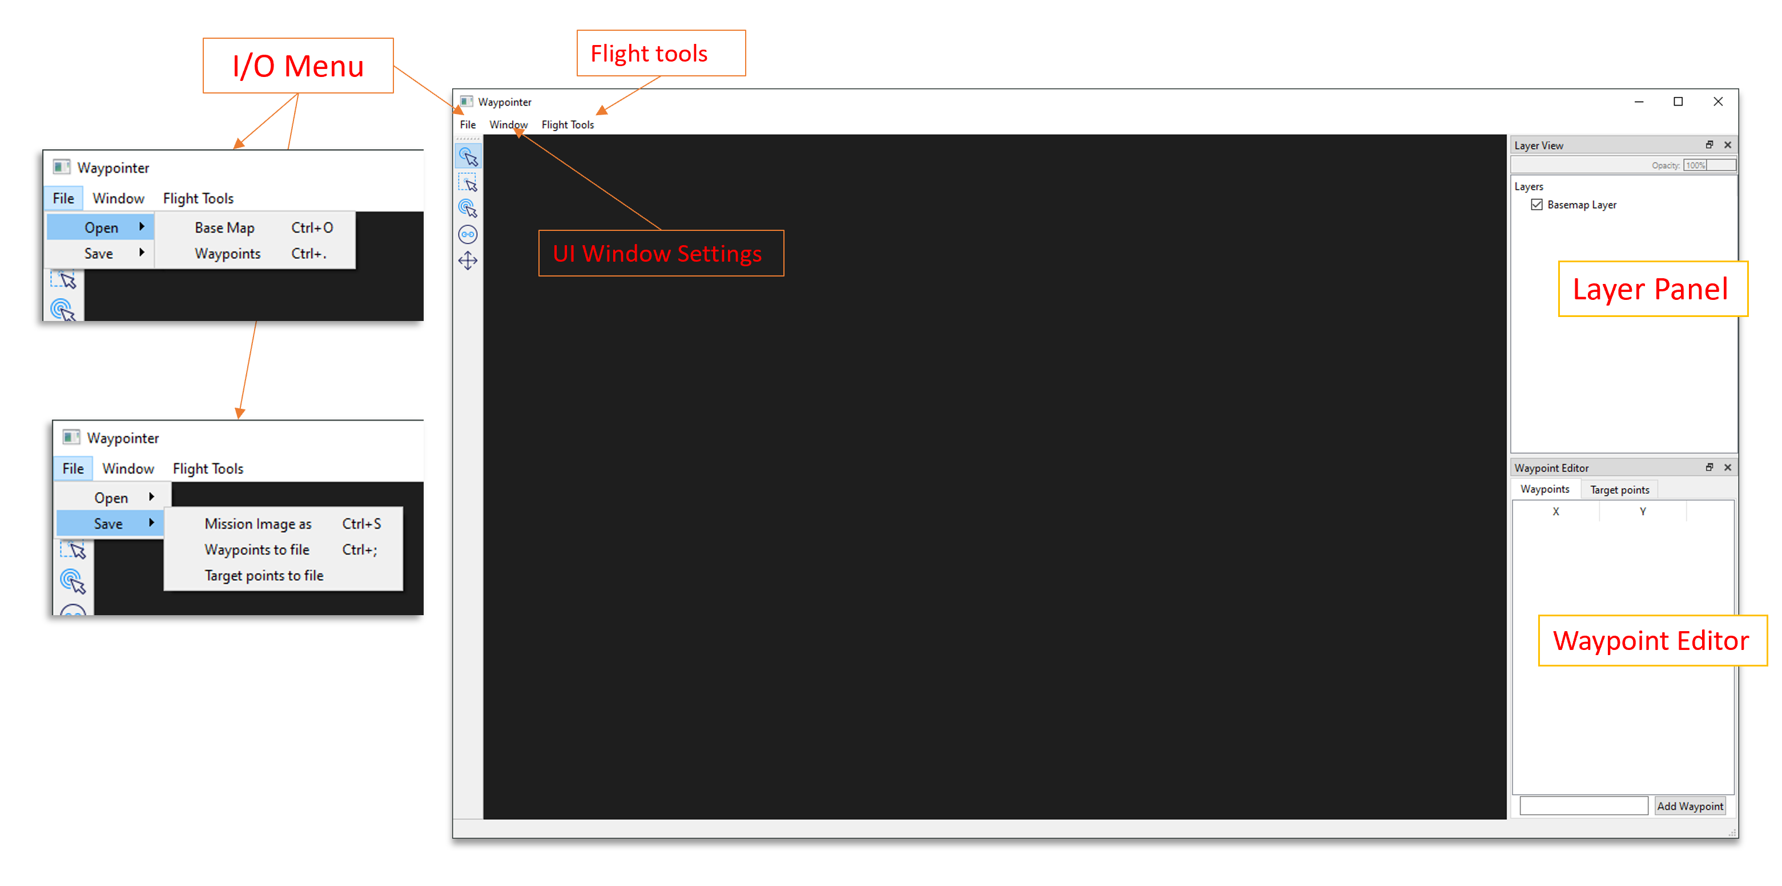
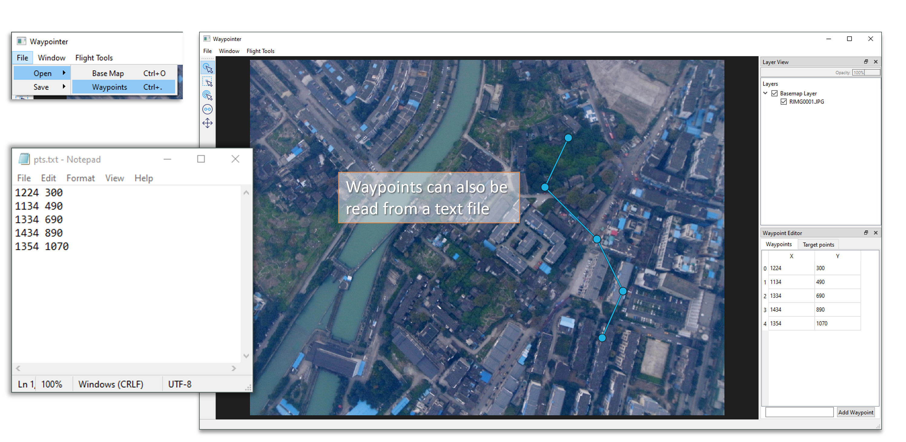
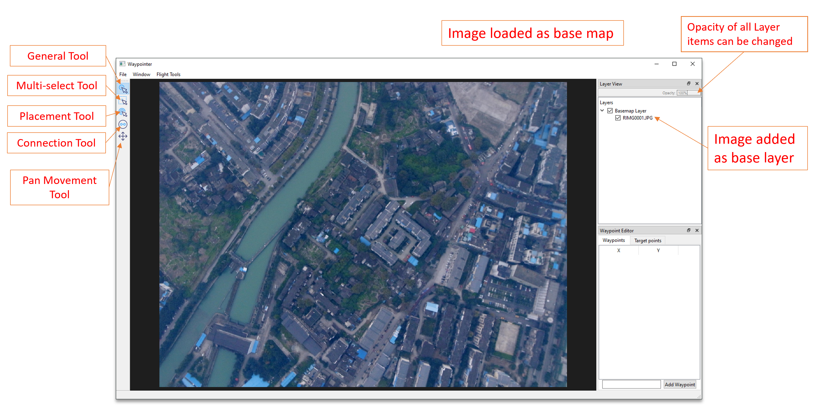
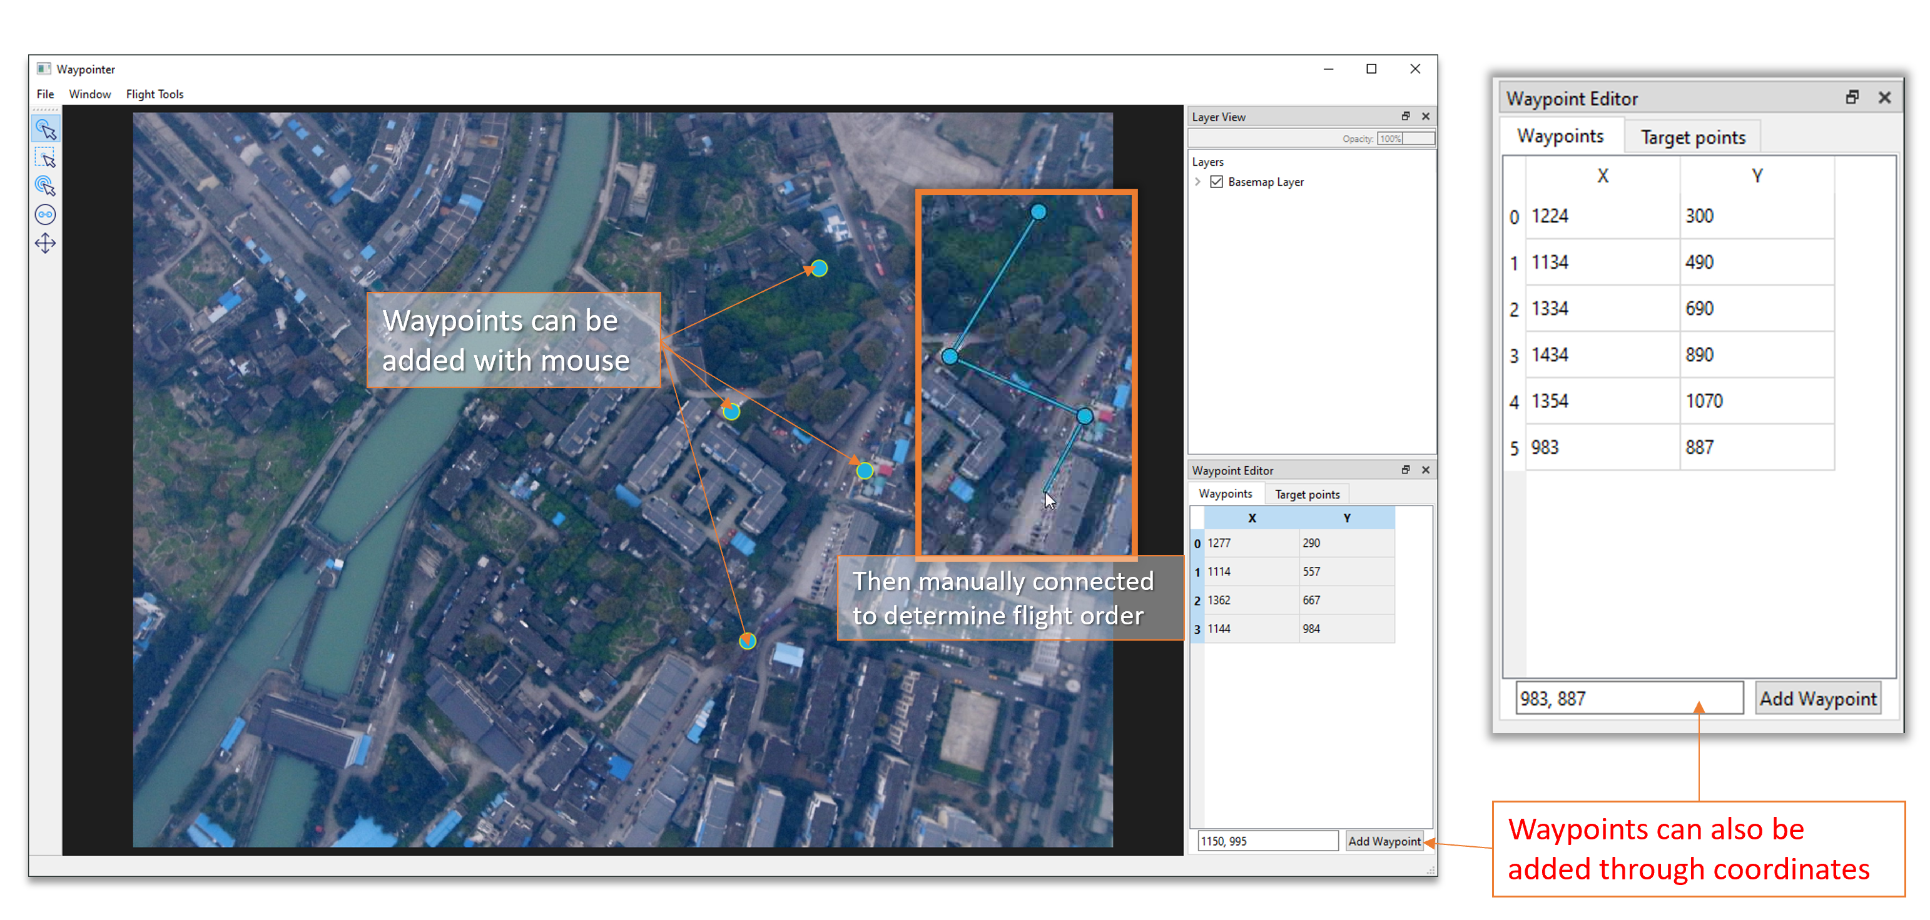
Waypointer UI Overview
User Guide: Waypointer
Flight Tools
The processing for running the navigation function within Waypointer is as follows:
File > Open > Base Map (select base map image)
File > Open > Waypoints (select csv file)
Flight Tools > Set Watch on Directory
Images can also be loaded for post-mission processing rather than collection from the watched folder. The process for running the navigation function is then:
File > Open > Base Map (select base map image)
File > Open > Waypoints (select csv file)
Flight Tools > Add Flight Image (select flight image)

